Slide 1
AI policies
Team 7

Slide 2
Agenda
I.What is AI?
II.How does AI affect
-Personal Data
-Jobs
-Industry
III.What Policies can be made to better control AI?

Slide 3
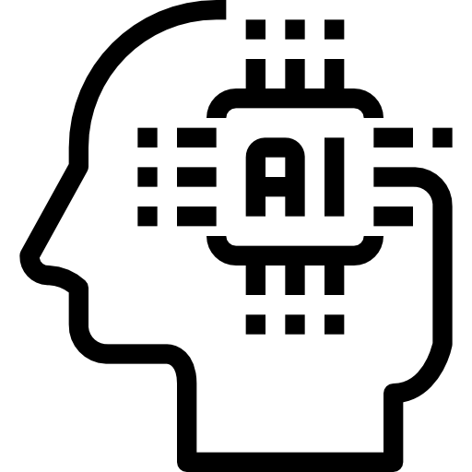
What is AI?
Simulated human level thinking done by machines
Most common form being Machine learning
AI mostly looks for patterns in given data and further predicts what should come next

Slide 4
AI
The effect on Personal Data

Slide 5
Data Exploitation
“People are often unable to fully understand what kinds of—and how many—data their devices, networks and platforms generate, process or share.” - Hafiz Sheikh Adnan Ahmed, Cybersecurity Professional
Deepfakes
Human Impersonation on Social Media
AI Supported Password Guessing
Notes:
Hafiz Sheikh Adnan Ahmed - cofounder and cio of AZAAN Business Intelligence & Infosys Services, company that helps businesses and governments with their cybersecurity.

Slide 6
Identification and Tracking
AI can be used to identify and track people.
Deanonymization
Privacy Concern
Opportunity for more data to be exploited
Notes:
-No longer anonymous
-if tracked can lead to other exploits home, work, public spaces

Slide 7
Inaccuracies and Biases
AI driven identification can lead to discriminatory or biased outcomes where people are misidentified or judged negatively. Such errors and biases disproportionately affect certain demographics.
Some examples
In some US states, PredPol algorithm is used to predict when and where crime will take place.
Lead to certain communities being more policed
IN 2018, Gender and race recognition software identified white men with 99% accuracy
Identified Dark skinned women with only 35% accuracy

Slide 8
AI
The effect on Jobs

Slide 9
Job Automation
“Back in April, Dropbox announced it was cutting 500 employees. In May, outplacement firm Challenger, Gray & Christmas let go of almost 4,000 people. And in July, the founder of an e-commerce startup said he laid off 90% of his support team.”
-Bethany Cianciolo (CNN)
-Goldman Sachs economists estimate that 300 million full-time jobs could be automated by AI
-Jobs related to tech and white collar jobs most likely to be replaced by AI
-Some experts remain hopeful that AI can be used more as a tool rather than replacement

Slide 10
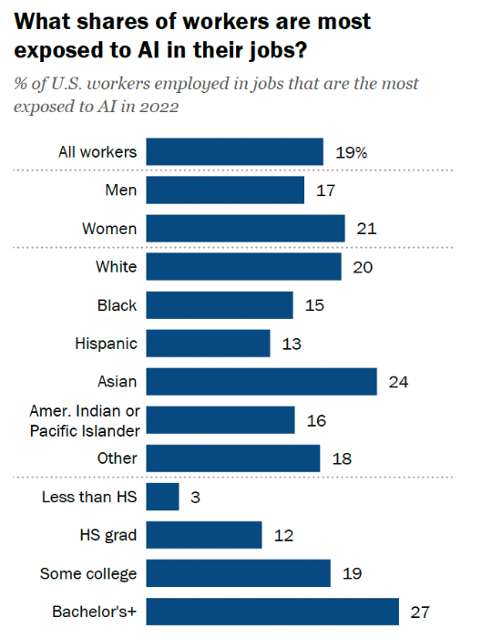
Jobs Affected
“About a fifth of all workers have high-exposure jobs; women, Asian, college-educated and higher-paid workers are more exposed. But those in the most exposed industries are more likely to say AI will help more than hurt them personally”
-Rakesh Kochhar (Pew Research Center)
-AI is used more commonly among workers in higher-paying fields
-Often times these jobs are related to research and analytics
-AI is being used as an assistant, being used in derivative and repetitive tasks
-Survey shows workers have a positive outlook on AI in the workplace

Slide 11



Commonly Used AI Tools
Scite - Research tool (Smart Citation)
ChatGPT - Generative chatbot
Codeium - AI code completion

Slide 12
Jobs Created
“Consider a grocery retailer or restaurant chain on the day that the NBA releases its playoff schedule. For cities that are hosting games, AI tools will one day be able to immediately realize that this news will adjust the demand forecast for foods like chicken wings and potato chips, which are associated with basketball viewing parties. AI tools will then quickly re-optimize decisions associated with inventory shipments, staffing and promotions.”
-Adam Elmachtoub(CNN)
-AI can do more than replace but also create new business strategies
-AI can go beyond human thinking bring new ways of thinking and utility
-AI is seen to create jobs as well as assist in them

Slide 13
AI and the Impact on Industry
Implementation and Integration
Automation
Data-driven Decisions
Enhanced Customer Experience

Slide 14


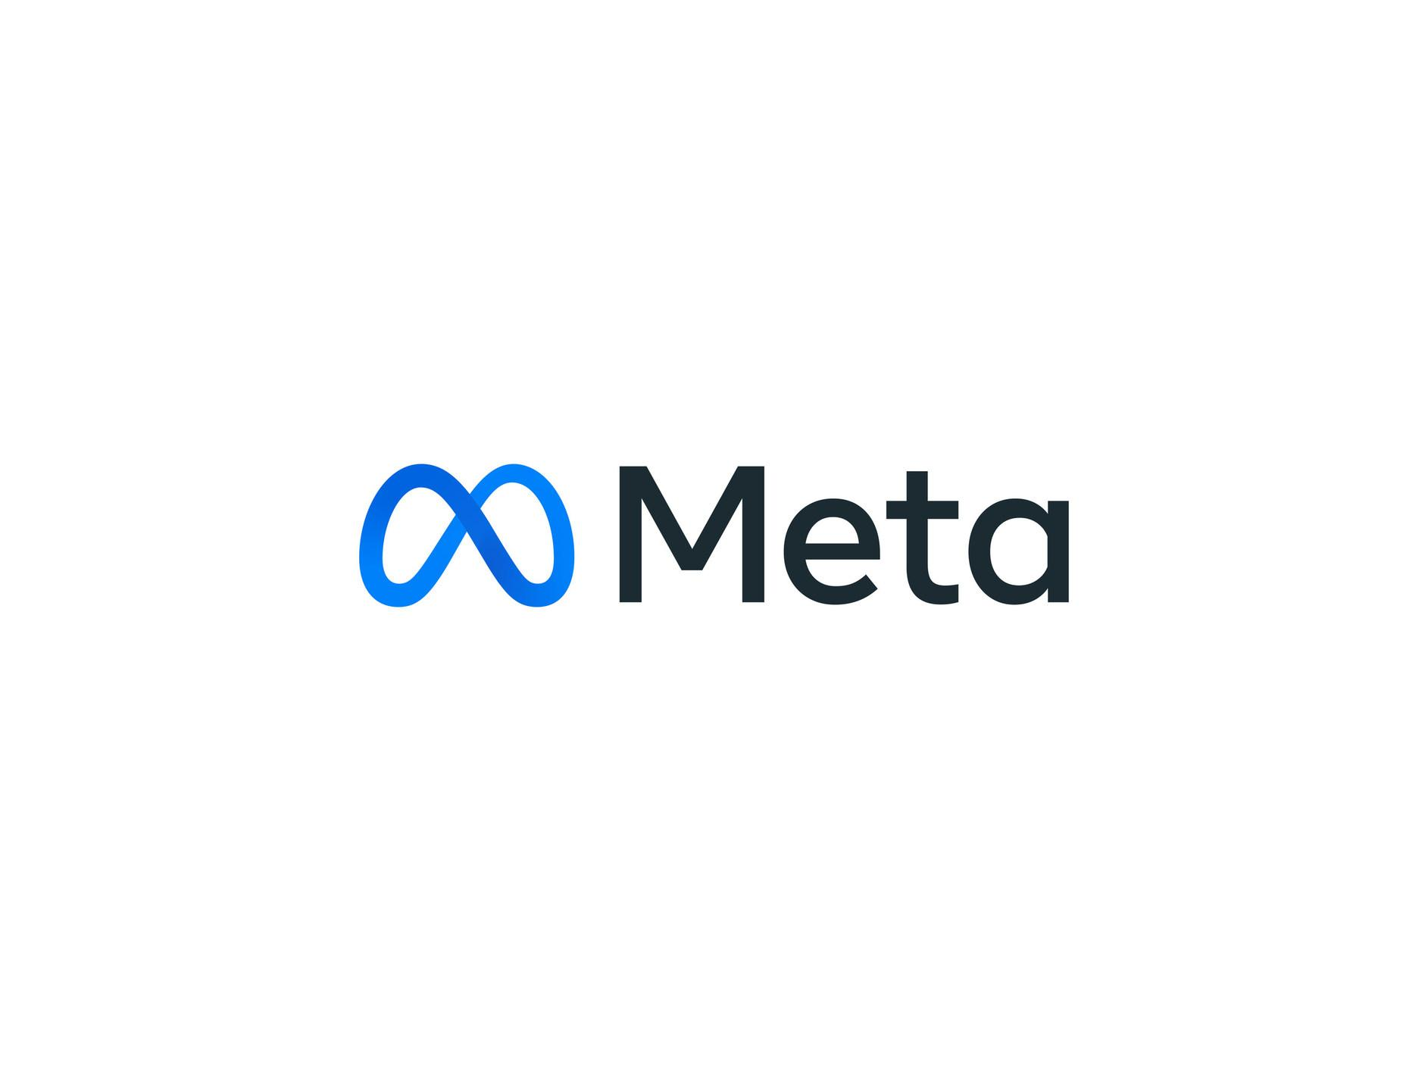
Companies with AI Policies
IBM
AWS(Amazon)
Meta
Notes:
Venturing over towards the corporate world we are going to take a look at three different companies Collin

Slide 15
IBM AI Policy
Augment Human Intelligence
Data and information belongs to the creator
Technology needs to be transparent and understandable
Mission Statement: AI is embedded in everyday life, business, government, medicine and more. At IBM®, we are helping people and organizations adopt AI responsibly. Only by embedding ethical principles into AI applications and processes can we build systems based on trust.
Notes:
Collin T

Slide 16
Amazon (AWS) AI Policy
Fairness: How a system impacts different subpopulations of users (e.g. by gender, ethnicity)
Explainability: Mechanisms to understand and evaluate the outputs of an AI system
Privacy and security: Data protected from theft and exposure
Robustness: Mechanisms to ensure an AI system operates reliably
Governance: Processes to define, implement and enforce responsible AI practices within an organization
Transparency: Communicating information about an AI system so stakeholders can make informed choices about their use of the system
Mission Statement: The rapid growth of generative AI brings promising new innovation, and at the same time raises new challenges. At AWS we are committed to developing AI responsibly, taking a people-centric approach that prioritizes education, science, and our customers, to integrate responsible AI across the end-to-end AI lifecycle.
Notes:
Collin T

Slide 17
Meta AI Policy
Privacy and Security
Fairness and inclusion
Robustness and safety
Transparency and control
Accountability and governance
Mission Statement: Our Responsible AI efforts are propelled by our mission to help ensure that AI at Meta benefits people and society. Through regular collaboration with subject matter experts, policy stakeholders and people with lived experiences, we’re continuously building and testing approaches to help ensure our machine learning (ML) systems are designed and used responsibly.
Notes:
Collin T

Slide 18
Conclusion
What Policies can be made to better control AI?
Notes:
Collin T

Slide 19
Possible Policies moving forward
Contain and control AI as a tool, not a replacement for workers
Where training data comes from and how it is used.
Understanding the impact of the technology being used.
Transparency on bias and ways to mitigate it.
Robust security for AI systems to prevent tampering and loss of data.
Conduct risk assessment
Create privacy requirements by design
Regularly conduct tests to ensure that such requirements are being upheld
Document all ways in which they attempt to minimize bias within any models/algorithms
Generate clear justification for using a model/algorithm
Notes:
Collin T

Slide 20
Q/A
Any final questions?

Slide 21
References
https://www.ibm.com/impact/ai-ethics
https://aws.amazon.com/machine-learning/responsible-ai/
https://ai.meta.com/responsible-ai/
https://www.newscientist.com/article/2166207-discriminating-algorithms-5-times-ai-showed-prejudice/
https://www.trendmicro.com/vinfo/us/security/news/cybercrime-and-digital-threats/exploiting-ai-how-cybercriminals-misuse-abuse-ai-and-ml
https://www.isaca.org/resources/news-and-trends/newsletters/atisaca/2021/volume-32/challenges-of-ai-and-data-privacy-and-how-to-solve-them
https://www.wgu.edu/blog/how-ai-affecting-information-privacy-data2109.html
https://hbr.org/2020/08/how-to-fight-discrimination-in-ai
https://www.cnn.com/2023/09/05/opinions/artificial-intelligence-jobs-labor-market/index.html

